Slide 1


Slide 2
Aggregate Functions
These functions return a single value after performing calculations on a group of values. Following are some of the frequently used Aggregate functions.

Slide 3
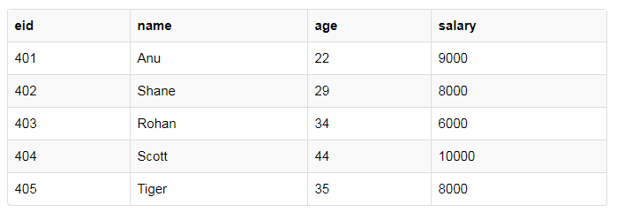
AVG() Function
Average returns average value after calculating it from values in a numeric column.
Its general syntax is,
SELECT AVG(column_name) FROM table_name
SELECT avg(salary) from Emp;

Slide 4
COUNT() Function
Count returns the number of rows present in the table either based on some condition or without condition.
Its general syntax is,
SELECT COUNT(column_name) FROM table-name
SELECT COUNT(name) FROM Emp WHERE salary = 8000;
SELECT COUNT(DISTINCT salary) FROM emp;

Slide 5
FIRST() Function
First function returns first value of a selected column
Syntax for FIRST function is,
SELECT FIRST(column_name) FROM table-name;
SELECT FIRST(salary) FROM Emp;
This function is supported in MS Access database.

Slide 6
LAST() Function
LAST function returns the return last value of the selected column.
Syntax of LAST function is,
SELECT LAST(column_name) FROM table-name;
SELECT LAST(salary) FROM emp;
This function is supported in MS Access database.

Slide 7
MAX() Function
MAX function returns maximum value from selected column of the table.
Syntax of MAX function is,
SELECT MAX(column_name) from table-name;
SELECT MAX(salary) FROM emp;

Slide 8
MIN() Function
MIN function returns minimum value from a selected column of the table.
Syntax for MIN function is,
SELECT MIN(column_name) from table-name;
SELECT MIN(salary) FROM emp;

Slide 9
SUM() Function
SUM function returns total sum of a selected columns numeric values.
Syntax for SUM is,
SELECT SUM(column_name) from table-name;
SELECT SUM(salary) FROM emp;

